Slide 1
Generative Timetable using Genetic Algorithm
Aanand Sunil Ingle & Gayatri Rameshwar Donatkar
Department of Computer Science
Sir Parashurambhau College, Pune

Slide 2
Project Members
1. Aanand Sunil Ingle (Backend Development)
2. Gayatri Rameshwar Donatkar (Frontend Development)

Slide 3
Project Topic
Web Application to Generate Timetables using AI

Slide 4
Technologies Used
- Backend: Flask (Python)
- Database: MySQL
- Frontend: HTML, CSS, JavaScript
- AI Algorithms: Genetic Algorithm
- Other Libraries: NumPy, Pandas

Slide 5
Existing System
Manual timetable creation is time-consuming and error-prone, especially for large institutions.

Slide 6
Proposed System
An AI-powered web application that generates conflict-free timetables by considering constraints like faculty availability, classrooms, and schedules.

Slide 7
Requirements
Software:
- Python, Flask, MySQL, HTML, CSS, JavaScript
Hardware:
- System with at least 8GB RAM & multi-core processor

Slide 8
Project Modules
1. Input Constraints
2. AI Algorithm for Timetable Generation
3. User Interface & Customization
4. Timetable Storage & Retrieval

Slide 9
What We Learned from This Project
- Application of AI in scheduling
- Full-stack development
- Database design & optimization
- Handling real-world constraints in software

Slide 10
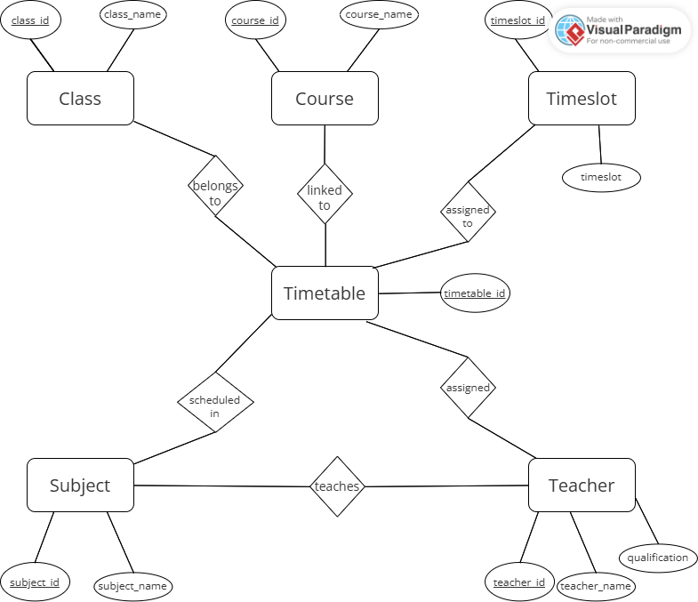
ER Diagram

Slide 11
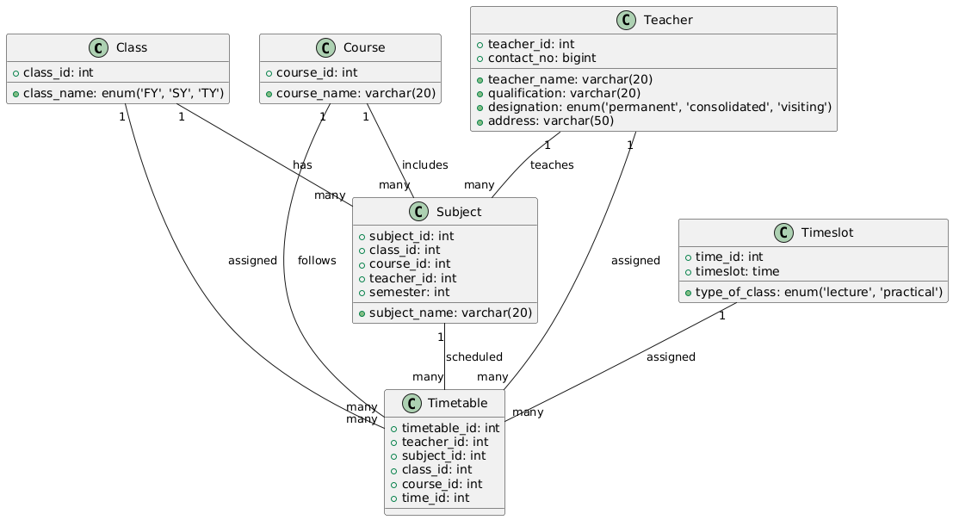
Class Diagram

Slide 12
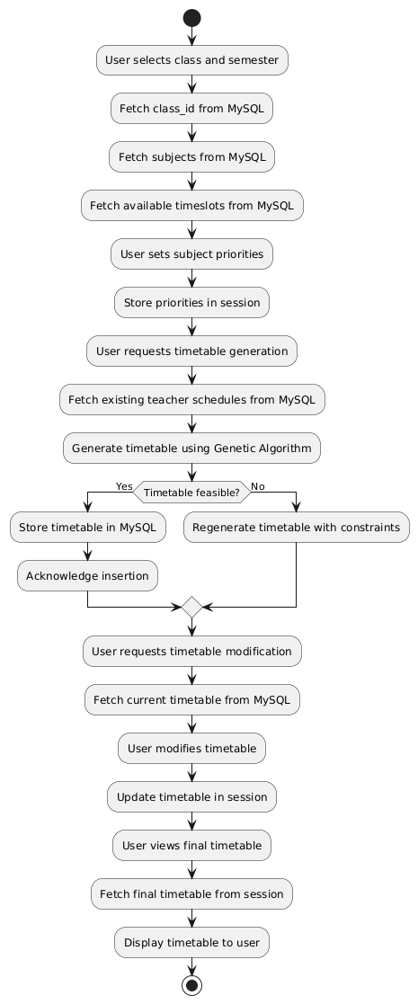
Activity Diagram

Slide 13
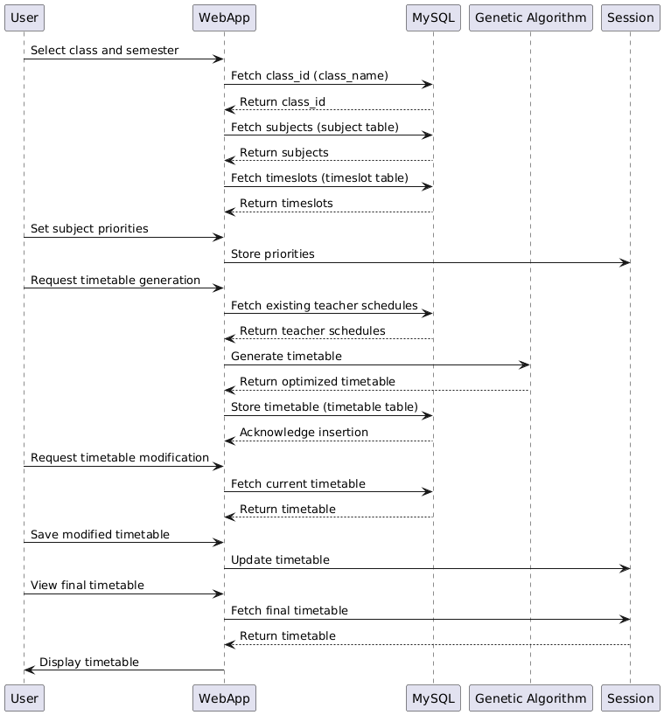
Sequence Diagram

Slide 14
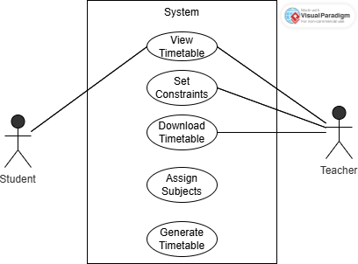
Use Case Diagram

Slide 15

Entering Constraints

Slide 16
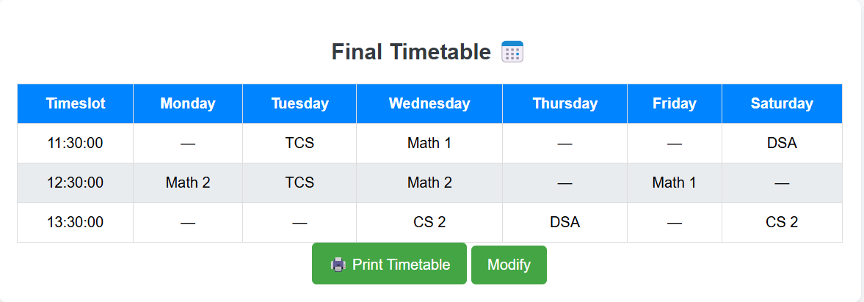
Timetable Generation

Slide 17
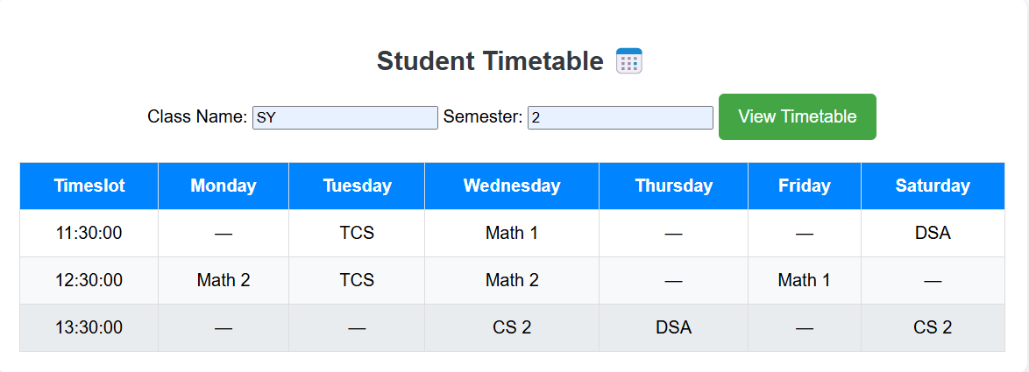
View Timetable

Slide 18
Future Enhancements
- Mobile application integration
- More intelligent conflict resolution
- Multi-campus support
- Advanced analytics for scheduling optimization

Slide 19
Limitations
• Currently supports only predefined constraints.
• Requires manual adjustments for unforeseen changes.

Slide 20
Bibliography and Reference
Research papers on scheduling algorithms.
Documentation for Python and MySQL.

Slide 21

Conclusion
Successfully developed an AI-powered web application for timetable generation.
Reduced manual effort and errors in scheduling.
Applied Genetic Algorithm to optimize timetables efficiently.
Gained hands-on experience in Flask, MySQL, and AI-based scheduling.

